Slide 1
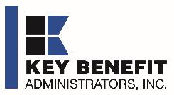

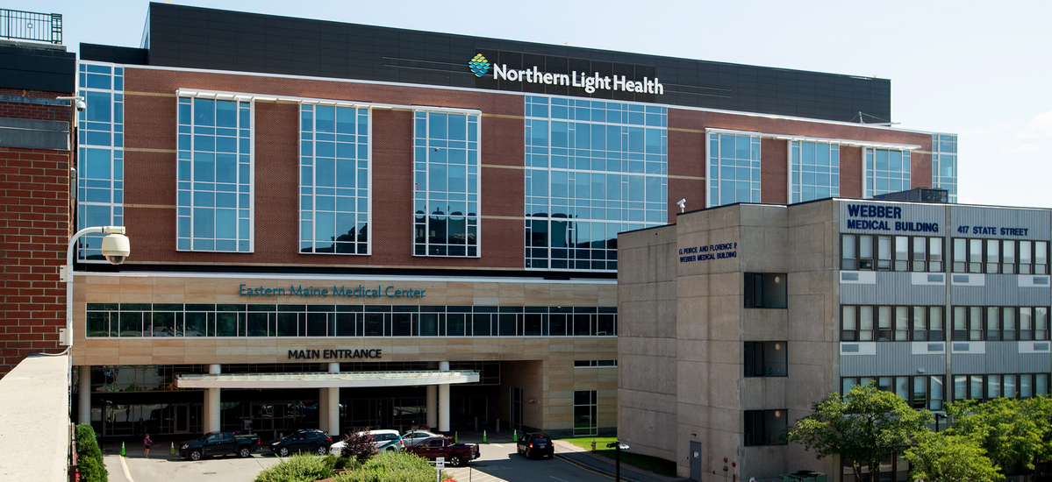
DIRECT-TO-EMPLOYER PLAN
August 1, 2024

Slide 2


Healthcare Leader in Private Labeled DTE Plans
Louisville, KY
OneHealth Plan
Cincinnati, OH
TCH Optimal
Bentonville, AR
Northwest Health Plan
Knoxville, TN
East Tennessee Health Plan
Meridian, MS
Affinity Health Plan
Fort Myers, FL
Lee Health Care Partners

Slide 3

Direct-to-Employer (DTE) Your health plan focused on a direct relationship with self-funded employers in Your market
YOU Pick the Name of the Health Plan
YOU Determine the Fees Charged
YOU Practice the Medicine
YOU Receive the Profits
WE Make it Successful

Slide 4

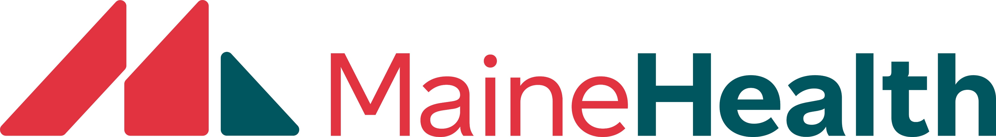
Direct-to-Employer Strategy: Increased Capture of Commercial Market Share
Northern Light Health Plan
Carrier #1
Carrier #2
Carrier #3

Slide 5
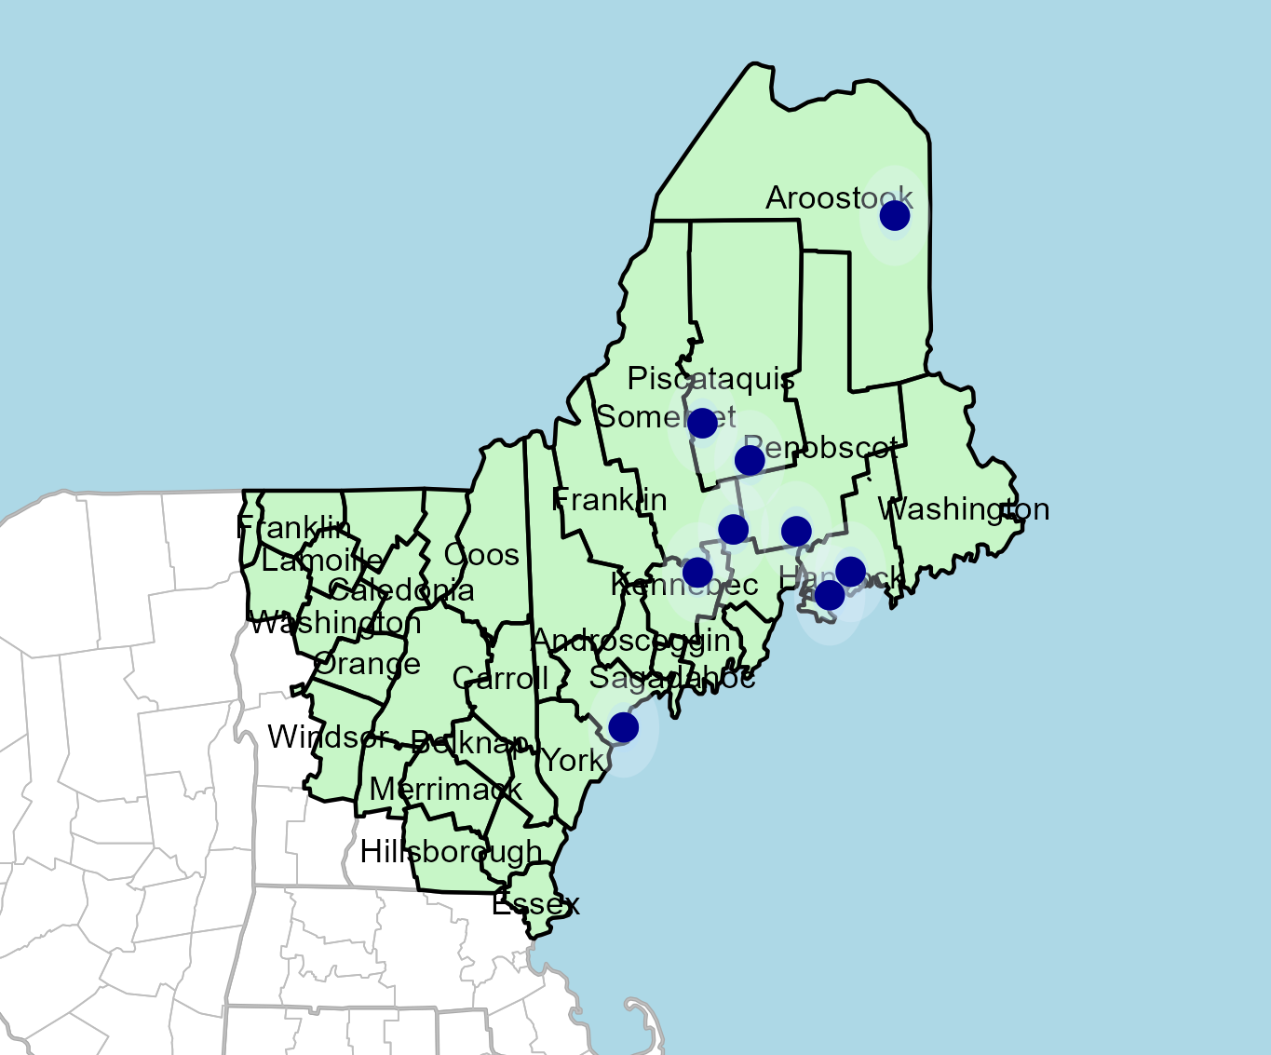
Mapping Opportunity for Northern Light Health
Target Market 951 Employers 140,000+ Employees 230,000+ Members
 | Total Employees
Commercial Employers With Headquarters: | 50-100 | 101-200 | 201-400 | 401-1000 | 1001-3000 | 3000+
Within 10 Miles of NLH Hospital | 334 | 174 | 105 | 58 | 10 | 6
Within 11-20 Miles of NLH Hospital | 156 | 54 | 37 | 16 | 7 | 1
Within 21-30 Miles of NLH Hospital | 163 | 75 | 32 | 17 | 3 | 2
Employees at Above Firms | 50-100 | 101-200 | 201-400 | 401-1000 | 1001-3000 | 3000+
Within 10 Miles of NLH Hospital | 25,050 | 26,100 | 31,500 | 40,600 | 18,000 | 63,195
Within 11-20 Miles of NLH Hospital | 11,700 | 8,100 | 11,100 | 11,200 | 12,600 | 3,000
Within 21-30 Miles of NLH Hospital | 12,225 | 11,250 | 9,600 | 11,900 | 5,400 | 9,791
Total Members at Firms | 50-100 | 101-200 | 201-400 | 401-1000 | 1001-3000 | 3000+
Within 10 Miles of NLH Hospital | 42,585 | 44,370 | 53,550 | 69,020 | 30,600 | 107,432
Within 11-20 Miles of NLH Hospital | 19,890 | 13,770 | 18,870 | 19,040 | 21,420 | 5,100
Within 21-30 Miles of NLH Hospital | 20,783 | 19,125 | 16,320 | 20,230 | 9,180 | 16,645

Slide 6
Direct-to-Employer Strategy: Only Available to Premier Health Systems
STRONG Brand Quality
EXTENSIVE Patient Access
AFFORDABLE Value Pricing
EXCELLENT Care Quality

Slide 7
DTE Network Concern: Northern Light Health Brand Quality
Hospital | Health System | Recommendation Percentile | CMS Stars Percentile | Mortality Percentile | Readmission Percentile | KBA Brand Quality Rating
Lincolnhealth | Mainehealth | 90 | 84 | NA | 83 | 77
Northern Light Mercy Hospital | Northern Light Health | 93 | 84 | 68 | 72 | 76
Stephens Memorial Hospital | Mainehealth | 86 | 84 | NA | 76 | 75
Maine Medical Center | Mainehealth | 74 | 100 | 82 | 94 | 70
Northern Light Inland Hospital | Northern Light Health | 71 | 30 | 57 | 67 | 68
Memorial Hospital, The | Mainehealth | 56 | 58 | 84 | 59 | 65
Waldo County General Hospital | Mainehealth | 53 | 58 | NA | 75 | 64
Franklin Memorial Hospital | Mainehealth | 42 | 58 | 65 | 63 | 61
Penobscot Bay Medical Center | Mainehealth | 45 | 84 | 70 | 56 | 61
Mid Coast Hospital | Mainehealth | 42 | 58 | 69 | 70 | 60
Northern Light AR Gould Hospital | Northern Light Health | 32 | 58 | 66 | 63 | 57
Northern Light Blue Hill Memorial Hospital | Northern Light Health | 32 | NA | NA | 89 | 52
Northern Light Eastern Maine Medical Center | Northern Light Health | 26 | 84 | 78 | 91 | 52
Northern Light Mayo Hospital | Northern Light Health | 20 | 30 | NA | 58 | 52
Northern Light Sebasticook Valley Hospital | Northern Light Health | 26 | NA | NA | 74 | 51
Northern Light Maine Coast Hospital | Northern Light Health | 12 | 58 | 59 | 60 | 49
Southern Maine Health Care | Mainehealth | 13 | 30 | 62 | 93 | 47
Northern Light CA Dean Hospital | Northern Light Health | NA | NA | NA | NA | NA
KBA heavily weights the HCAHPS recommendation rate in our brand quality rating as it comes from patients.
Northern Light low HCAHPS recommendation rates are concerning for the establishment of a DTE network

Slide 8
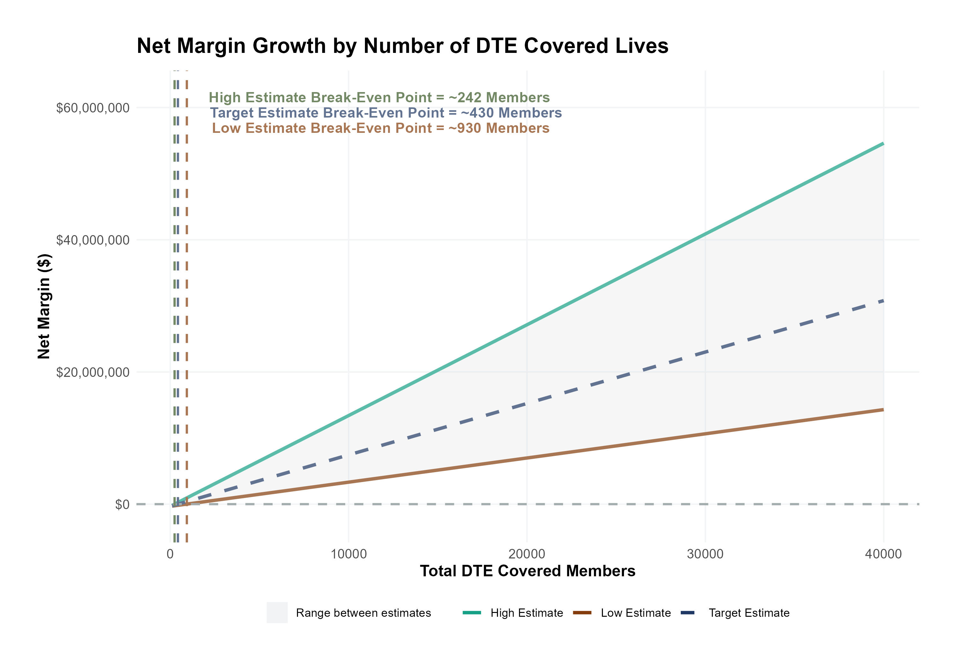
Estimated Financial Returns and Assumptions
Patient Steerage Assumptions
KBA currently estimates that Northern Light Health has 32% inpatient market share and 21% outpatient market compared to hospitals/clinics within 20 miles of a NLH hospital. Based on other DTE networks, we expect steerage to be:
SINGLE-YEAR PROJECTION
Low
Target
High
65%
77.4%
85%
Commercial Margin Assumptions
KBA observes a NLH 32% commercial margin. Conservatively, we model the DTE to be 5% below commercial (10 percentage-point price reduction with a 5 percentage-point price increase from easier billing):
Low
Target
High
18%
24%
32.3%

Slide 9
SINGLE YEAR SUMMARY
DTE Covered Members Financial Analysis | DTE Covered Members Financial Analysis | DTE Covered Members Financial Analysis | DTE Covered Members Financial Analysis | DTE Covered Members Financial Analysis | DTE Covered Members Financial Analysis | DTE Covered Members Financial Analysis | DTE Covered Members Financial Analysis
Target estimate (see slide 9 for assumptions). All monetary values in thousands of dollars | Low (conservative) estimate. All monetary values in thousands of dollars | Low (conservative) estimate. All monetary values in thousands of dollars | Low (conservative) estimate. All monetary values in thousands of dollars | Low (conservative) estimate. All monetary values in thousands of dollars | Low (conservative) estimate. All monetary values in thousands of dollars | Low (conservative) estimate. All monetary values in thousands of dollars | Low (conservative) estimate. All monetary values in thousands of dollars
DTE Members | Pre-DTE Revenue | Pre-DTE Margin | DTE Revenue | DTE Incr. Revenue | DTE Total Margin | DTE Incr. Margin | Net Margin Less DTE Fees
100 | $ 305K | $ 74K | $ 782K | $ 477K | $ 151K | $ 77K | $ -252K
500 | $ 1,527K | $ 371K | $ 3,910K | $ 2,384K | $ 754K | $ 383K | $ 59K
1,000 | $ 3,053K | $ 741K | $ 7,821K | $ 4,767K | $ 1,507K | $ 766K | $ 448K
2,500 | $ 7,634K | $ 1,853K | $ 19,552K | $11,919K | $ 3,768K | $ 1,915K | $ 1,615K
10,000 | $30,535K | $ 7,412K | $ 78,210K | $47,675K | $15,074K | $ 7,662K | $ 7,452K
20,000 | $61,070K | $14,824K | $156,419K | $95,350K | $30,148K | $15,324K | $15,234K
 | Note: DTE = Direct-to-Employer | Note: DTE = Direct-to-Employer | Note: DTE = Direct-to-Employer | Note: DTE = Direct-to-Employer | Note: DTE = Direct-to-Employer | Note: DTE = Direct-to-Employer | Note: DTE = Direct-to-Employer
NOTE: Please see detailed financial analysis and assumptions are in the extended analysis report.
Financial projections do not include 340B contribution margin, which could represent $136 PMPM by optimizing 340B through Rx plan design, NLH’s approved site(s) with network integration, and development of NLH’s proprietary PBM program.

Slide 10



Founded in 1979 and headquartered in Indianapolis, IN​
Full-service TPA specializing in the administration of self-funded health plans and population health management​
One of the country’s largest independently-owned TPAs
The Key Family is a commonly-held group of benefits related organizations with:​
3,000+ corporate clients​
3.0 million members under management​
Exclusive Relationship
We know The Market – Agents, Networks, and MGAs

Slide 11





A Partner You Can Trust
OUR OBJECTIVES ARE ALIGNED
WE KNOW THE
MARKET
COMPLETELY TRANSPARENT
WE HAVE THE SOPHISTICATION AND INFRASTRUCTURE TO EFFECTIVELY COMPETE
Jack Hill, Executive Vice President – KBA
630-878-7539 * jack.hill@keybenefit.com

